Slide 1
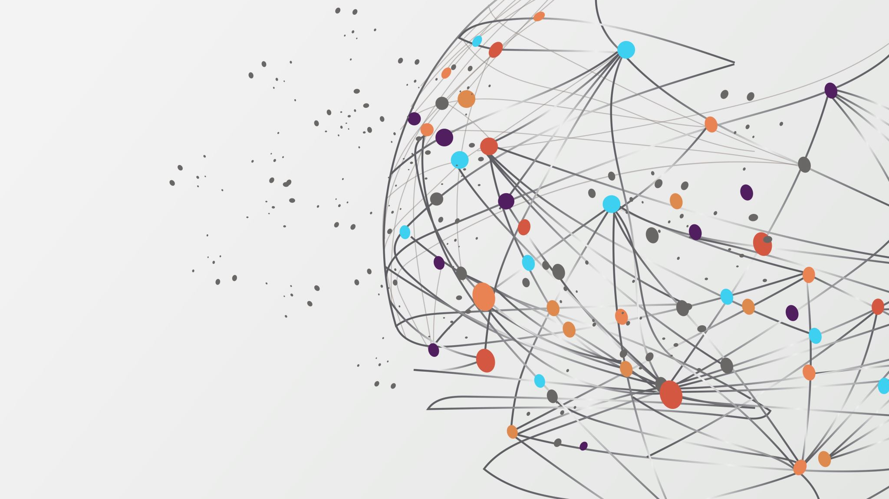
Modernizing WinForm UI with WebView2
Using WebView2 to Render UI for Desktop Applications
David Day

Slide 2

Introduction
Chief Technology Officer at Voluntaryism In Action
Senior Software Engineer at Susco Solutions
Proudly out of Lockport Louisiana
Yes, most of this PowerPoint was built with a combination of ChatGPT and PowerPoint Designer
Notes:
Susco Solutions is a sponsor of SQL Saturday.

Slide 3
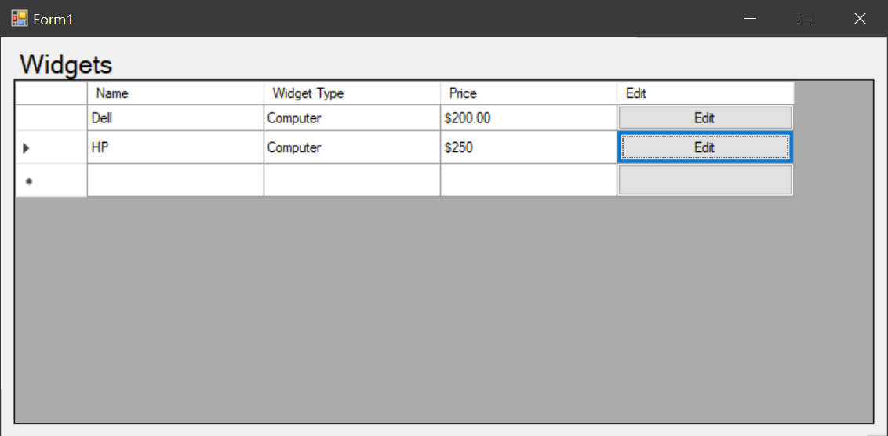
Background
WinForm projects were released in 2002 with the introduction of the .NET framework.
Win32 apps in general have been around since 1993.
The WebView2 control was introduced in 2020 to replace the old WebBrowser control.
Starting around 2022 I started toying with the idea of using a WebView2 for my UI.
Notes:
Point 2: VB3 anyone?
Point 3: Microsoft finally gave in and acknowledged that IE was terrible browser and so they rebuilt everything off of Chromium. Point 4: I have an Ionic/Cordova background for mobile development and so the idea was doing something very similar in WinForm apps.

Slide 4
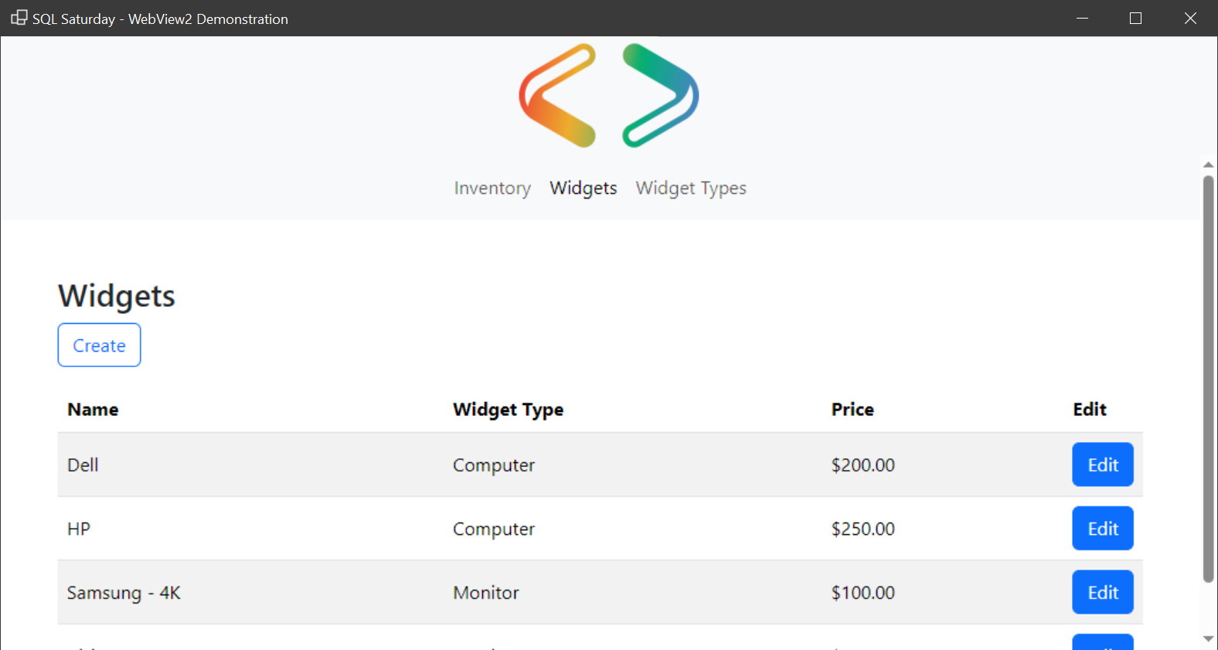
Why Modernize?
Older technology
Customizing and theming limitations
Limited controls
Decreasing popularity
Notes:
Point 1: Let’s face it, .NET WinForm apps are 22 years old.
Point 2: It is extremely tedious to build out a custom theme for WinForm controls, especially entire component libraries.
Point 3: You are essentially limited to the existing Win32 controls like buttons, checkboxes, radiobuttons, textboxes. Modern controls like switches and spinners are not available out of the box.
Point 4: It is much easier to get HTML/CSS/JavaScript support than it is to get WinForm support.

Slide 5
Housekeeping
Project is written in VB.NET
The database is a strongly typed DataSet that is serialized and deserialized in the application startup and shutdown.
The logger simply writes to the console.
There is no ORM being used.
The web portion is architected in an MVC style
The webpages are HTML, CSS, and native JavaScript with Bootstrap 5.
Notes:
Point 1: I promise I take a .NET approach and not a VB specific approach.
Point 4 and 5: In larger applications, it may be more prudent to leverage an ORM and a more robust logger.
Point 6: MVC is what I’m most comfortable with, but really any architecture pattern could be implemented.

Slide 6
10,000ft Overview
The WebView2 loads a webpage.
The webpage requests data from the WinForm application.
The WinForm application sends data back to the webpage.
The webpage listens for incoming messages from the WinForm application.

Slide 7

File Structure
Services
This is where any business or domain logic would live.
For this basic project this is where the loggers are defined.
WebAssets
This is where any third-party libraries (e.g., Bootstrap) or shared CSS/JavaScript files would live.
WebPages
This is where the HTML and CSS pages live.
The way I have it setup is such that entities have their own directory with a search page and upsert page.
WebServer
This is where any communication lives.
The entity controllers are here.
The simplified request/response classes are here.
Notes:
This is setup to be an MVC style project, so this was how I setup the file structure.

Slide 8
WebAssets and WebPages
The most important part behind files that get used in the WebView2 is that
Build Action must be “Content”
Copy to Output Directory must be “Copy if newer”
This allows the files to be included in the build directory.
Notes:
Show a in the Solution Explorer the file properties.

Slide 9
Requests and Responses
WebView2Request
Contains a Body, Method, Origin, and URL properties.
Contains method to assert valid requests.
Contains helper methods to derive information from requests.
WebView2Response
Contain Body, Status, and read-only IsOk properties.
Contain helper methods to generate typical responses, e.g., 200, 404, 500, etc.
Notes:
Show the two classes.

Slide 10
Controllers
Controllers store the table name of the respective controller and a collection of delegates named routes that represent the “endpoint” and respective method to execute.
There is a BaseController that must be inherited (aka abstract) which hold overridable methods that do basic tasks.
Each entity has its own controller that inherits from the BaseController and setup their routes.
Routes will accept a request and return a response.
Notes:
Show the BaseController and one of the entity controllers.

Slide 11

Configuring WebView2
The WebView2 essentially only needs to do four things to allow interaction between the client and the WinForm application:
A call to EnsureCoreWebView2Async must be made.
The IsWebMessageEnabled property must be true.
The WebMessageReceived event must be setup to monitor requests from the client.
A call to Navigate must be made to load the webpage.
Notes:
Show the code in the FormMain

Slide 12
Virtual Host Mapping
Instead of relying on relative paths in the webpages, the WebView2 allows setup virtual host mapping that allows us to point to a user-friendly URL.
This is done by calling the SetVirtualHostNameToFolderMapping method.
Notes:
Show the SetVirtualHostNameToFolderMapping call and an example of it being used in the WidgetTypes/Index

Slide 13
Communication To and From the Client
When communicating to and from the client and WinForm application, unlike traditional web servers we cannot use asynchronous requests like fetch.
From client to the WinForm application, we must call window.chrome.webview.postMessage.
From WinForm application to the client, we must call ExecuteScriptAsync.
To monitor requests from WinForm application, I recommend dispatching an event and listening to the event in JavaScript.
Notes:
Show the buildWebRequest and Index fetchData
Show the end of WebMessageReceived
Show the dispatchMessageReceived event and Index messageReceived
Walkthrough a request from start to finish

Slide 14
Demonstration
Notes:
Show things like setting up a breakpoint in the BaseController to simulate a long running request as well as caveats like the Widgets/Upsert needing not only the received record but all child records for the dropdown.

Slide 15
Benefits
Provides on-screen keyboard for tablets.
If using proper HTML, defaults like enter key for form submission are handled.
Much more variety in UI considering the plethora of component libraries out there.

Slide 16
Enhancements
Controllers can have decorators that handle authentication and authorization.
Not all HTTP methods were used in this example and there could be a better way to handle PUT vs POST vs PATCH.
A slicker integration might be a single-page application pattern where the webpages are defined in the file structure but loaded into a single page to prevent hard navigations.
Notes:
Explain that this was a very simple demonstration and so no everything that could be done was done. Also show that WinForm controls can integrate with WebView2 pages by showing the image.

Slide 17
Q&A

Slide 18
Thank You!
Demo and PowerPoint available on GitHub at github.com/dday9
Want to learn Visual Basic .NET, go to vblessons.com
Want to donate to a good cause, go to viaction.org/donate

